Slide 1

MCA Major Project Mid Term Evaluation
SkillSync
Under the guidance of
Mrs. Swami Nisha Bhagirath
Department of Computer Applications
Faculty of Science, Technology and Architecture
Manipal University Jaipur
By
Fathima Reneesha P
23FS20MCA00085
2023-25

Slide 2
Outline
Introduction
Motivation
Process Model
Software Requirement Specification (SRS)
Data Flow Diagram (DFD)
Output
Conclusion
Future Scope

Slide 3
Introduction
SkillSync is an AI-powered interactive platform designed to bridge the gap between mentors and learners. By leveraging advanced algorithms, SkillSync analyzes user profiles, skills, and learning preferences to provide tailored mentorship and skill development opportunities.
This system streamlines the learning and mentoring process by ensuring individuals find the most suitable mentors while helping experts connect with the right learners efficiently.
This project aims to enhance the mentoring experience by offering personalized learning paths, AI-driven mentor matching, interactive knowledge-sharing sessions, and real-time guidance, creating a dynamic and engaging ecosystem for career and personal growth.

Slide 4
Motivation
Many students, freelancers, and professionals struggle to find individuals who match their skill level and learning objectives. A dedicated platform that facilitates networking based on AI-driven mentor matching, shared skills, and interests can enhance learning, collaboration, and career growth.
Bridging the Gap: The Need for a Skill-Based Networking Platform
Difficulty in finding mentors and study partners.
Lack of personalized, real-time guidance for skill development.
Absence of a dedicated AI-driven mentorship platform.
Limited opportunities for interactive learning and collaboration.
How SkillSync Will Improve This?
Offers dedicated spaces for live mentorship, skill challenges, and hands-on collaboration on projects.
Encourages an active learning community through peer reviews, discussions, and knowledge-sharing sessions.

Slide 5
Process Model
SkillSync is following Waterfall Model, the development would follow a linear and sequential approach, where each phase must be completed before moving to the next.
Requirement Analysis: Define all project features and finalize requirements before development.
System Design: Create UI/UX designs, database structure, and plan system architecture.
Implementation (Development): Develop the platform step by step, completing one module before moving to the next.
Testing: Test each module and the complete system only after full development.
Deployment: Launch the final version on a cloud server after successful testing.
Maintenance: Fix critical issues and release updates in future versions.

Slide 6
Software Requirement Specification (SRS)
Introduction
Purpose: SkillSync is a platform to learning and provide tailored mentorship and skill development opportunities.
Scope: Provides skill-based matching, and communication features.
Users: Students (job seeks) & Freelancers (recruiters).
Constraints: Internet required, works on modern browsers.
2. Functional Requirements
User Authentication & Profiles: Secure login system with user role differentiation (Mentor/Learner).
AI-Driven Mentor Matching: Automatic pairing based on skills, interests, and learning preferences.
Real-Time Collaboration: Discussions, and interactive Q&A forums.
Gain Project Experience: Hands-on Experience through project collaborations.
Knowledge Sharing: Peer reviews, community discussions, and resource sharing.
Progress Tracking: Dashboard with mentorship metrics, skill improvements, and achievements.
Notification System: Alerts for mentorship requests, session reminders, and updates.

Slide 7
3. Non-Functional Requirements
Scalability: Supports a growing user base and large data transactions.
Performance: Ensures fast response times and real-time interactions.
Security: Implements data encryption, secure authentication, and access control.
Usability: Intuitive interface with easy navigation for mentors and learners.
4. System Architecture
Frontend: React.js for an interactive user experience.
Backend: Node.js with Express for handling requests and data management.
Database: MongoDB for storing user profiles, sessions, and mentorship details.

Slide 8
5. Constraints
Requires stable internet connectivity for real-time interactions.
AI-based mentor matching may evolve over time to improve accuracy.
6. Assumptions and Dependencies
Users must provide accurate skill and interest details for better matching.
The platform depends on third-party APIs for AI-Based MatchMaking.

Slide 9
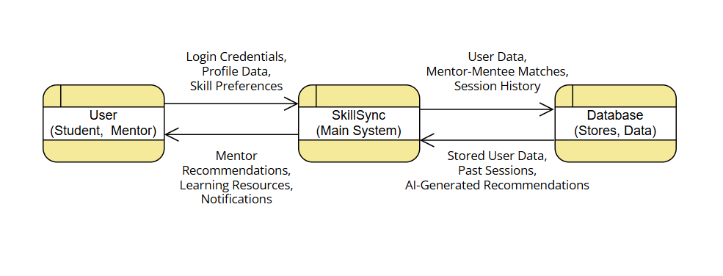
Data Flow Diagram
This Level 0 Data Flow Diagram (DFD) provides a high-level overview of how SkillSync facilitates mentor-learner connections through AI-driven matching.

Slide 10
User (Student, Mentor
Users interact with SkillSync by:
Logging in and providing profile details (skills, preferences, experience).
Receiving mentor recommendations, learning resources, and notifications for updates.
SkillSync (Main System)
The core system handles:
User authentication & profile management
AI-driven mentor-mentee pairing based on skills and interests
Session tracking & communication
Retrieving and storing user data from the database
3. Database (Stores, Data)
Stores and retrieves:
User data (profiles, preferences)
Mentor-mentee matches
Session history and AI-generated recommendations

Slide 11
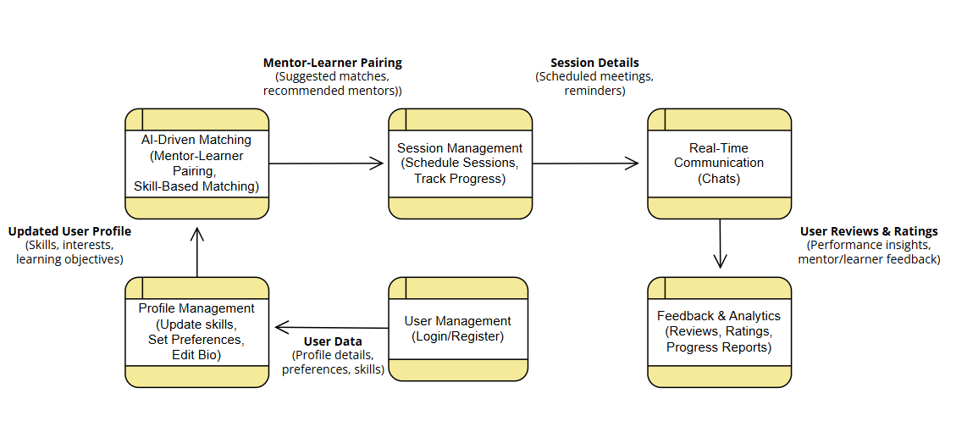
This Level 1 Data Flow Diagram (DFD) details how SkillSync processes user data, matches mentors and learners, manages sessions, facilitates communication, and tracks progress.

Slide 12
Key Components & Data Flow:-
User Management – Handles user registration and login, storing profile details, preferences, and skills.
Profile Management – Users can update skills, set preferences, and edit bios, which updates their profile data.
AI-Driven Matching – Uses skills and interests to suggest the best mentor-learner pairings.
Session Management – Allows users to schedule and track learning sessions, sending reminders.
Real-Time Communication – Supports chats between mentors and learners for seamless interaction.
Feedback & Analytics – Collects reviews, ratings, and progress reports to improve learning outcomes.

Slide 13
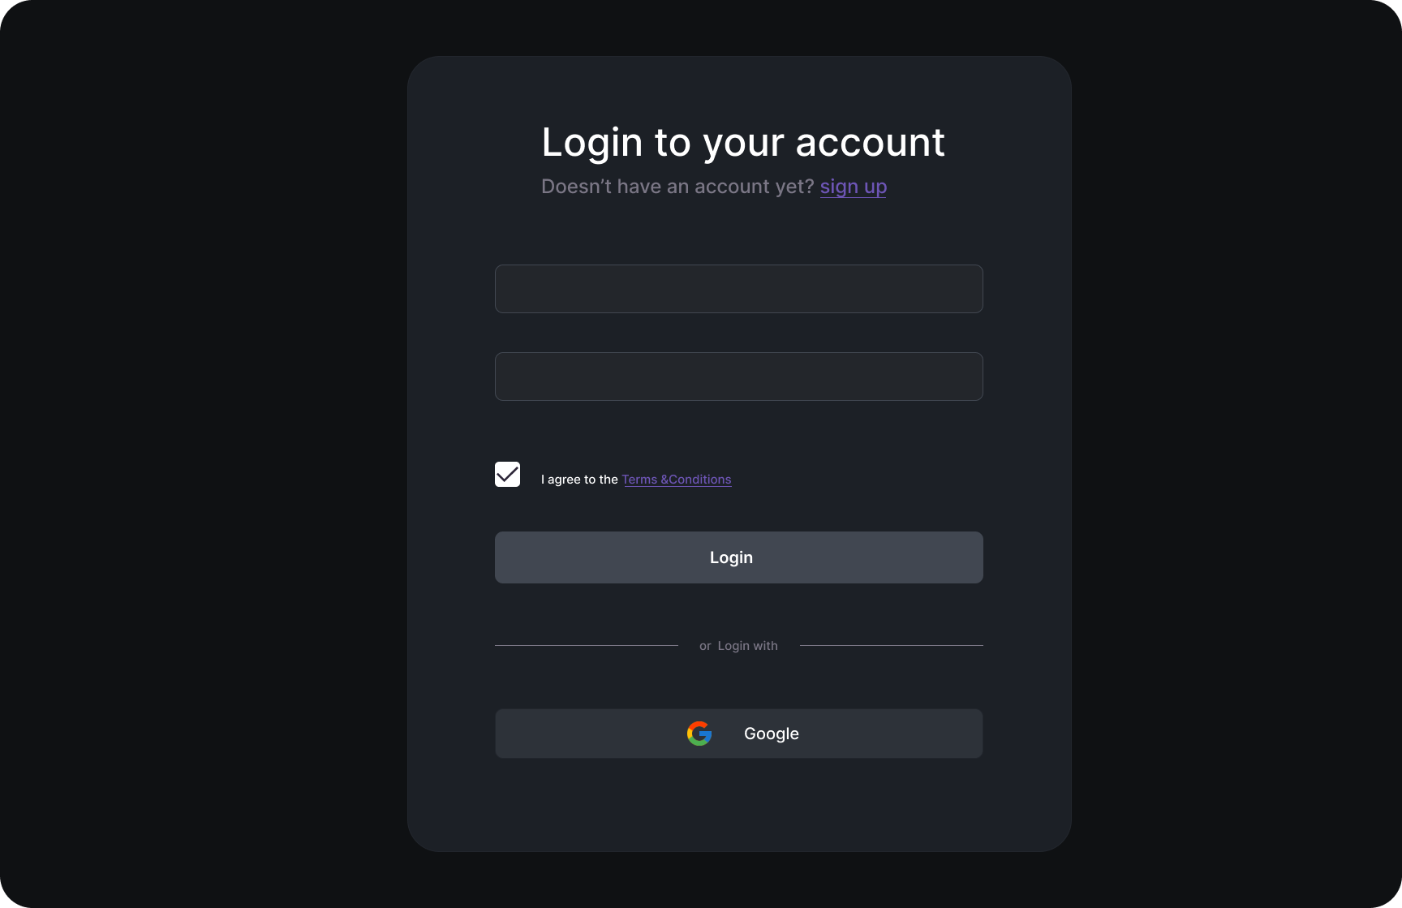
Output
Login Page
Features
Minimal UI – Clean and modern dark-themed design for an intuitive user experience.
Standard Authentication Using JWT – Users can log in using email and password credentials.
Terms & Conditions Compliance – Checkbox ensures user acknowledgment of platform policies.
Primary Login Button – Clearly visible for easy access to the platform.
Social Login Integration – Allows quick sign-in via Google authentication.
Secure & User-Friendly – Ensures data protection while maintaining seamless navigation.

Slide 14
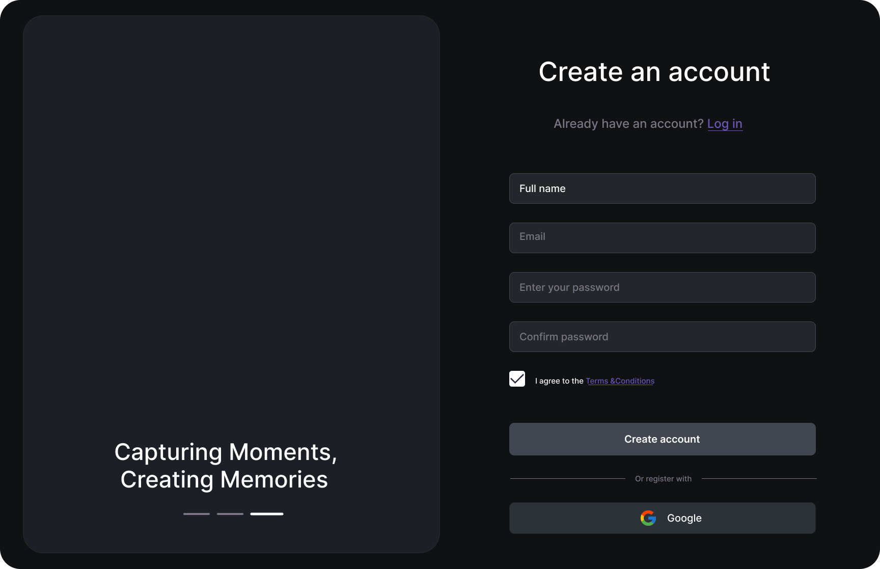
Signup Page
Features
Minimal UI – A sleek, dark-themed design ensures a modern and engaging experience.
Easy Registration – Users can sign up by entering their full name, email, and password.
Password Confirmation – Enhances security by requiring users to confirm their password.
Terms & Conditions Compliance – A checkbox ensures users agree to the platform’s policies.
Primary Signup Button – Clearly designed to guide users through the registration process.
Social Signup Integration – Allows users to register quickly using Google authentication.
Visual Appeal – The left panel balances the form with a smooth, aesthetic layout, enhancing user experience

Slide 15
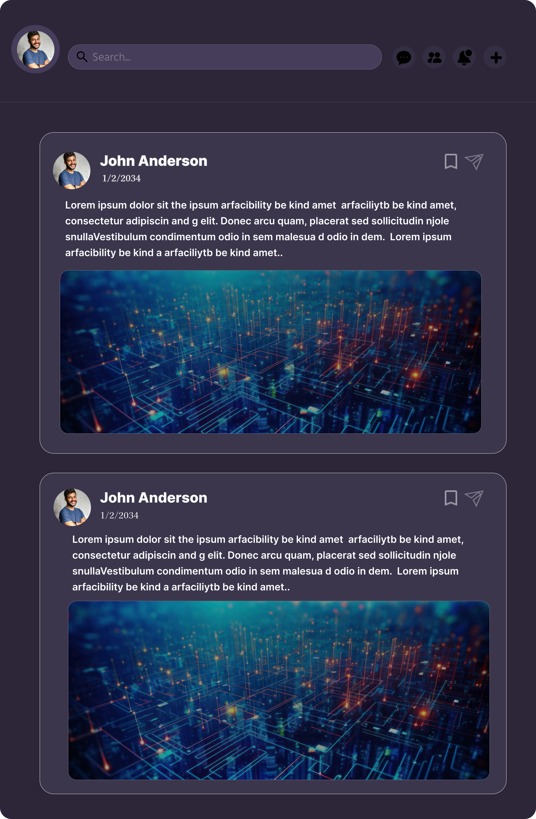
Modern UI Design – A sleek, dark-themed interface with a well-structured layout for an engaging user experience.
Profile-Based Posts – Users can share updates, insights, or discussions with a visually appealing card-based post format.
Search Bar Integration – A top-positioned search bar allows users to easily find content and connections.
Social Engagement Features – Includes options for bookmarking posts and sending direct messages for networking.
Image-Rich Content – Posts support high-quality images, enhancing visual appeal and engagement.
User-Friendly Navigation – Intuitive design elements ensure seamless browsing and interaction within the platform.

Slide 16
Conclusion
SkillSync is an AI-powered interactive platform designed to bridge the gap between learners, mentors, and professionals by facilitating skill-based mentoring and collaboration. By leveraging AI-driven matching, SkillSync connects users based on their expertise, learning goals, and career aspirations. The platform fosters an environment for real-time mentorship, interactive learning, and skill development, empowering individuals to grow through personalized guidance, structured discussions, and hands-on challenges.
Key Features
User-Friendly Interface – Ensures a seamless and accessible experience for both mentors and learners.
AI-Driven Matching – Connects users based on skills, learning preferences, and career goals.
Live Mentorship & Collaboration – Provides real-time learning through interactive sessions and knowledge sharing.
Secure & Structured Learning – Ensures a safe, well-organized environment for effective mentorship.
Personalized Learning Paths – Offers tailored mentorship programs and progress tracking.

Slide 17
Future Scope
SkillSync evolve into a comprehensive career development platform, ensuring better job opportunities and skill growth for users.
Key Features:-
AI-Driven Learning Analytics – Provides insights into learning patterns and mentor effectiveness.
Career & Internship Opportunities – Expands mentorship to include career guidance and internship matching.
Real-Time Progress Tracking – Enables users to monitor their mentorship journey and learning growth.

